Slide 1
EEG Analysis of Motor Execution vs. Imagery: Neural Patterns and Dynamics
Flavio Caroli

Slide 2
Introduction
How similar are the neural patterns of real movement and imagined movement?
Using the PhysioNet EEG Motor Movement/Imagery Dataset
Prior research suggests they are similar
Applying multiple techniques to “verify” this

Slide 3
Data Analysis and Preprocessing

Slide 4
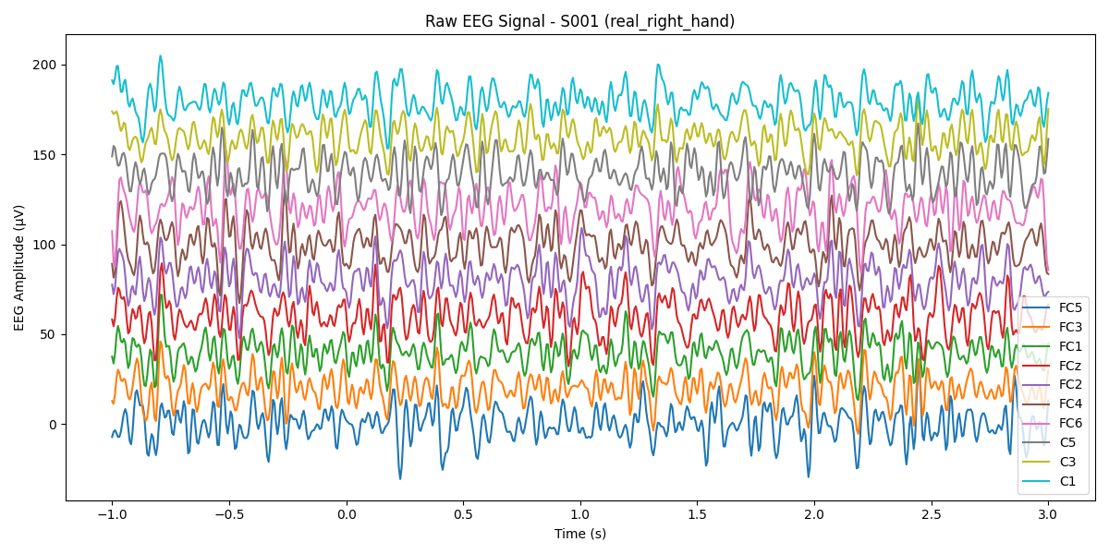
Raw EEG Signal

Slide 5
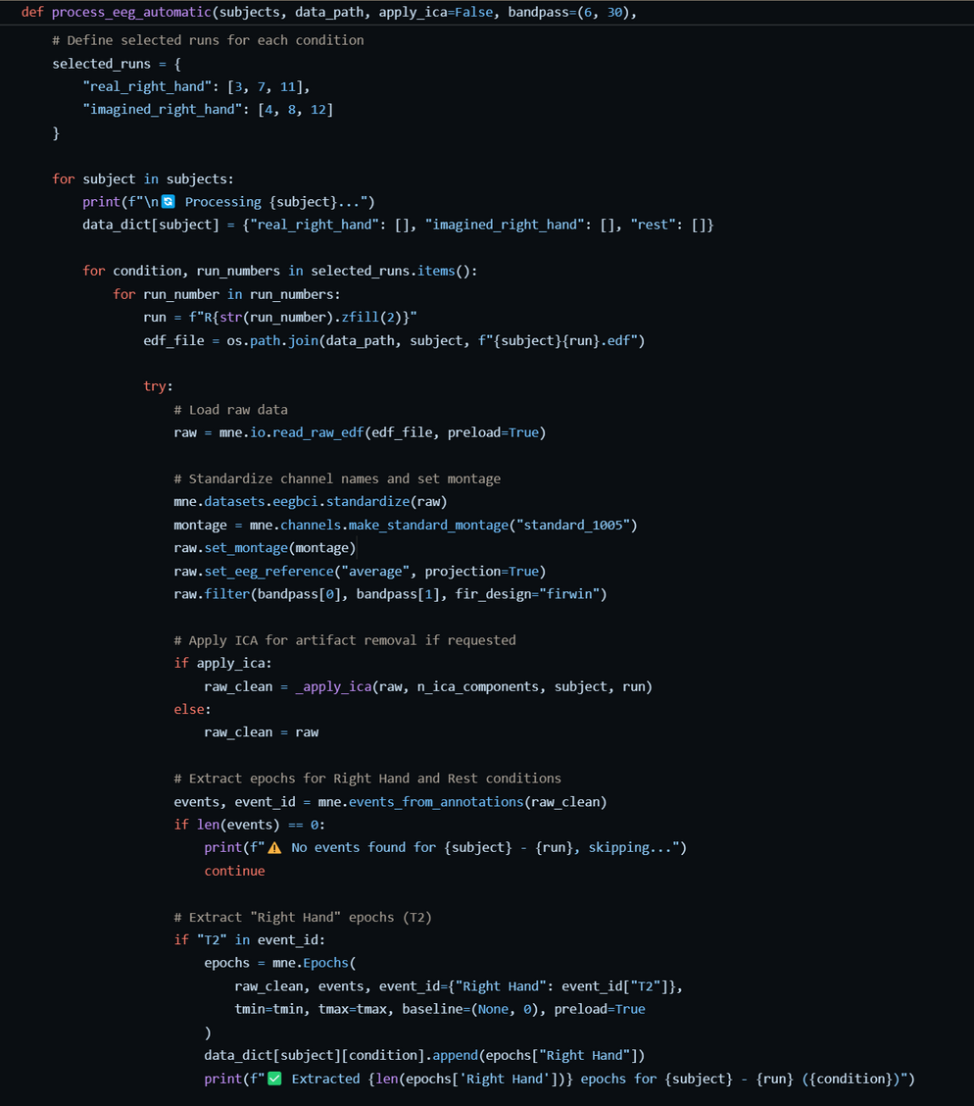
Preprocessing Pipeline
Bandpass Filtering (6-30 Hz)
ICA (Automatic or Manual)
Extract and Concatenate the Epochs

Slide 6
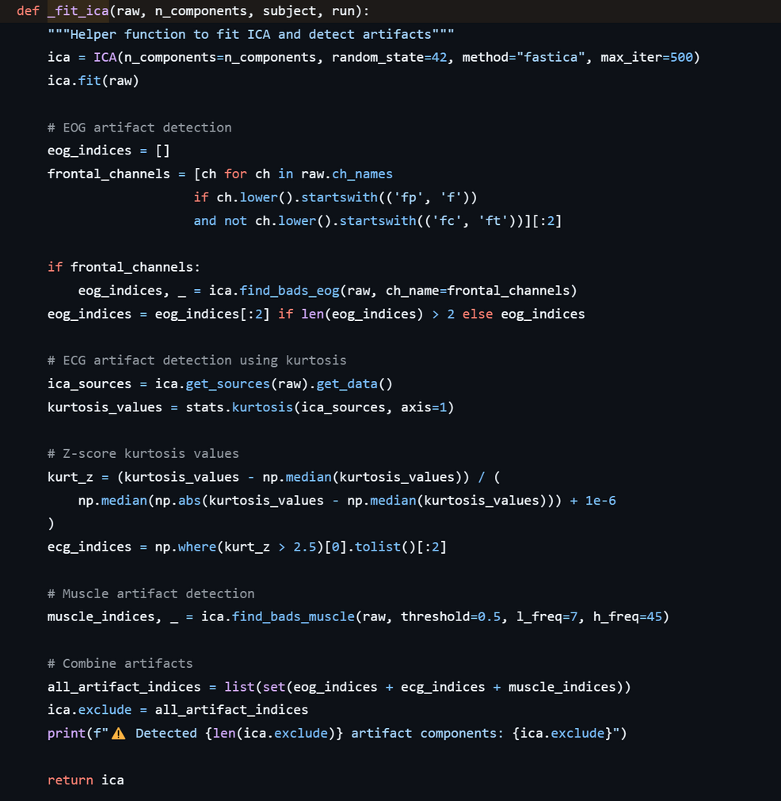
ICA Artifacts
Find bad EOG
Find bad ECG
Find Muscle Artifacts

Slide 7
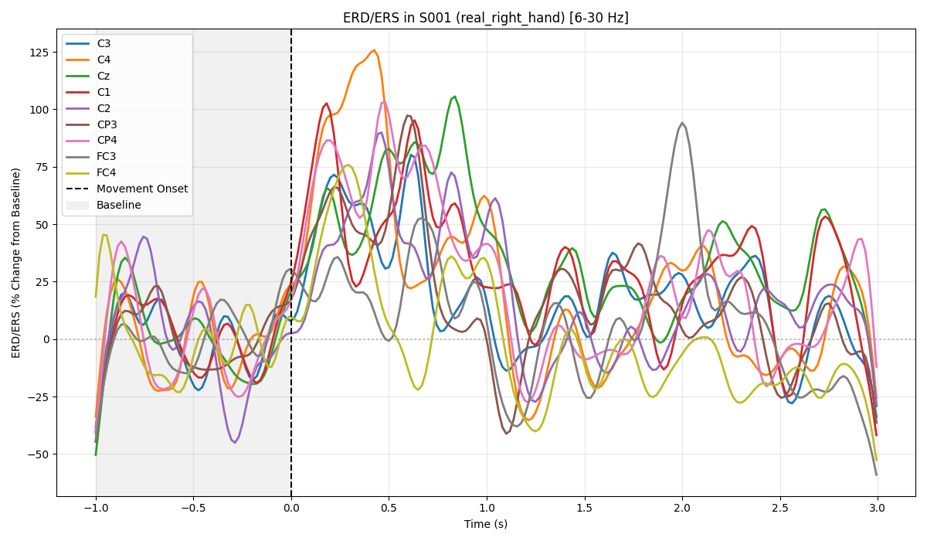
Event-Related Des/Synchronization

Slide 8
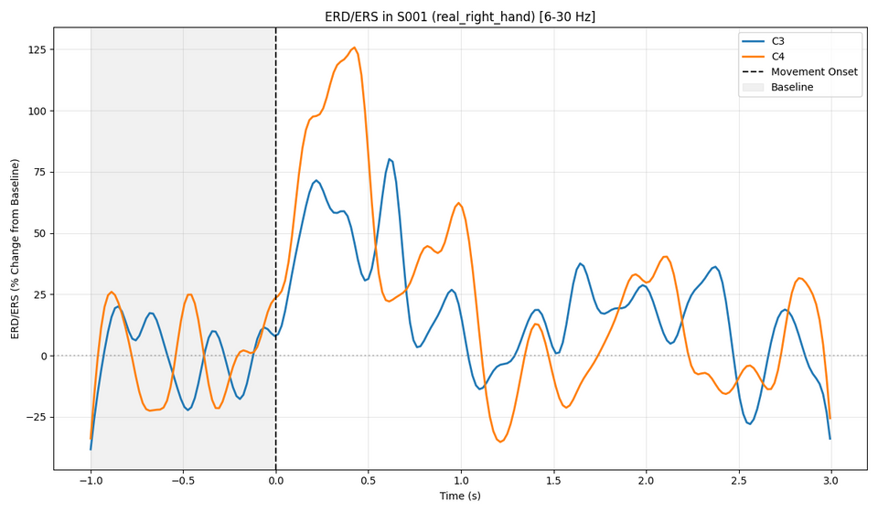
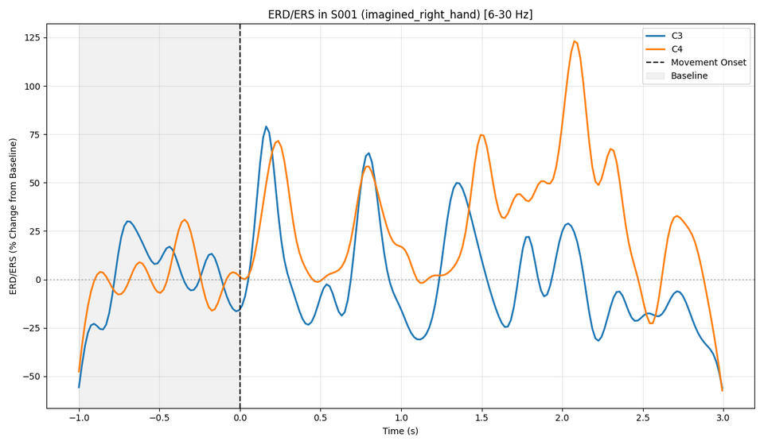
ERD/ERS in Real and Imagined Movement

Slide 9
Connectivity Metrics

Slide 10
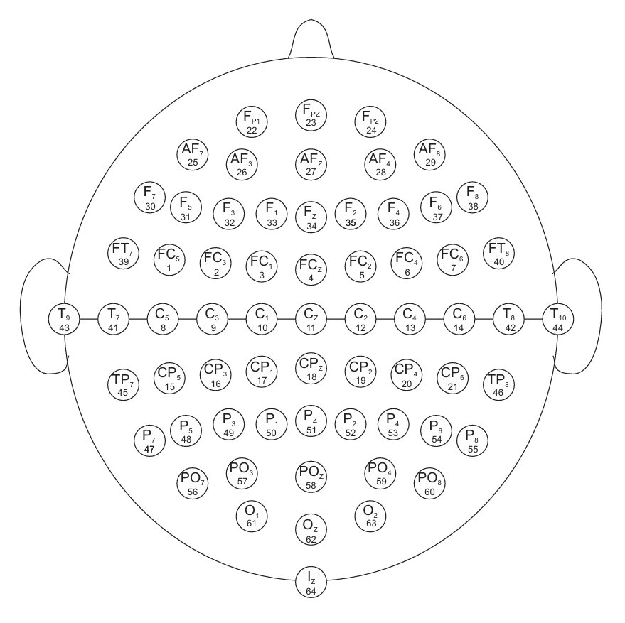
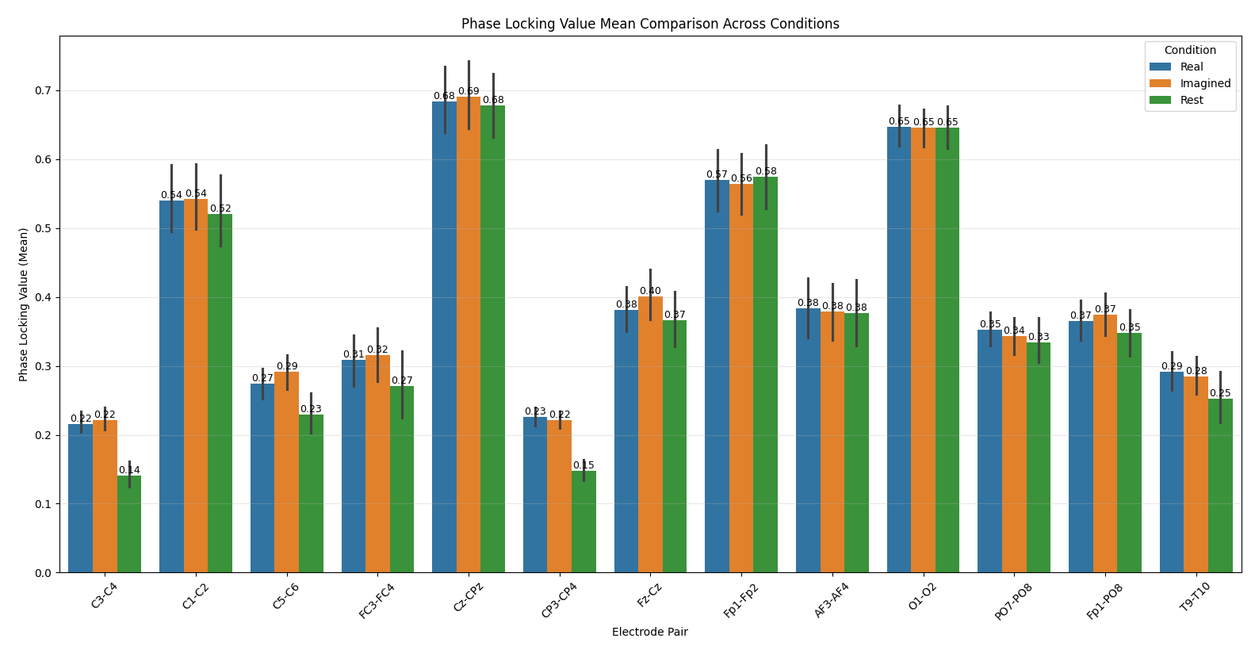
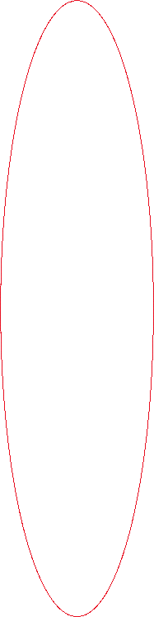
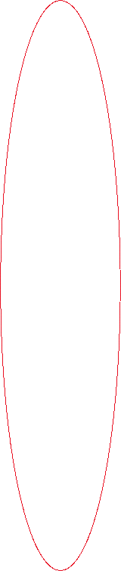
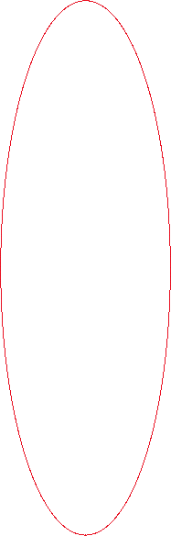
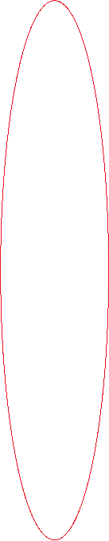
PLV Mean

Slide 11
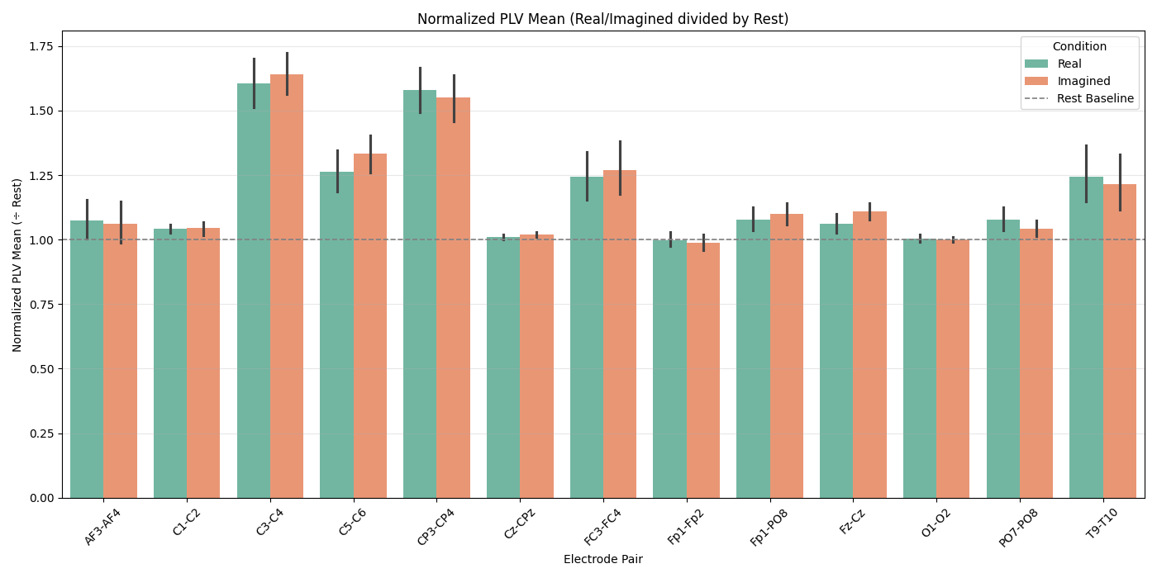
Normalized PLV Mean

Slide 12
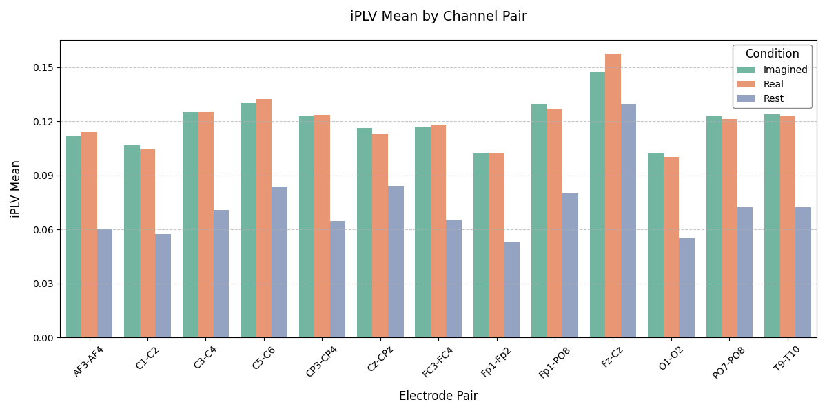
iPLV Mean

Slide 13
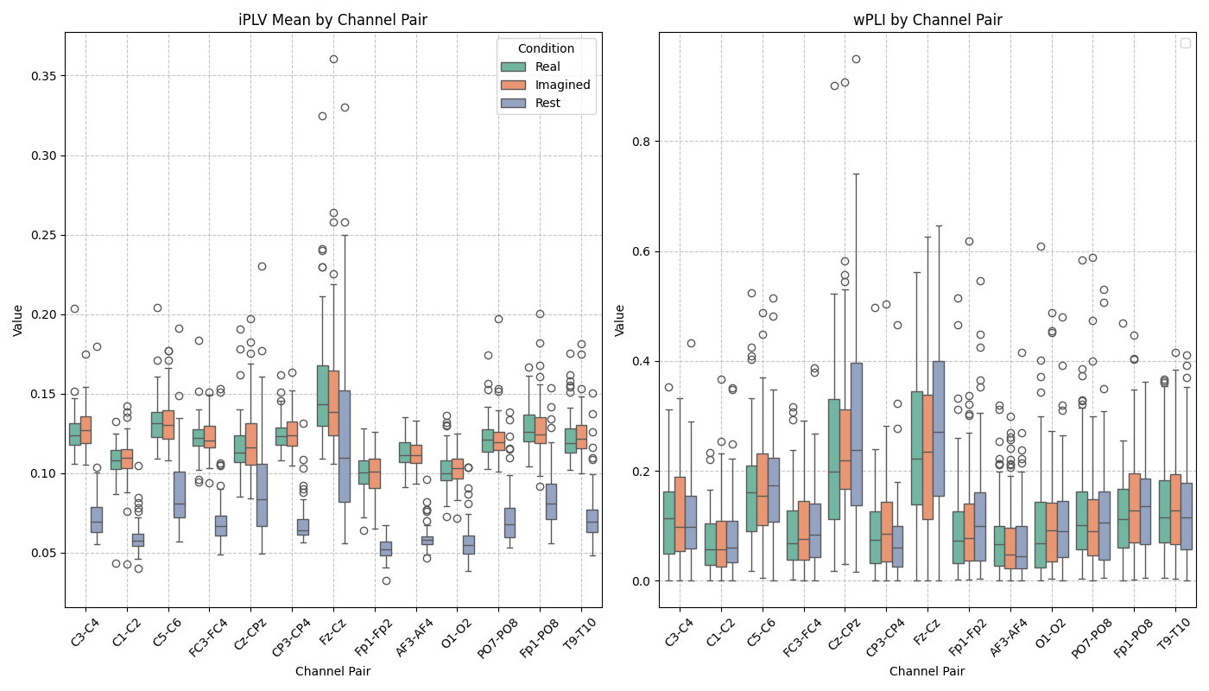
Notes:
Just a very nice graph!

Slide 14
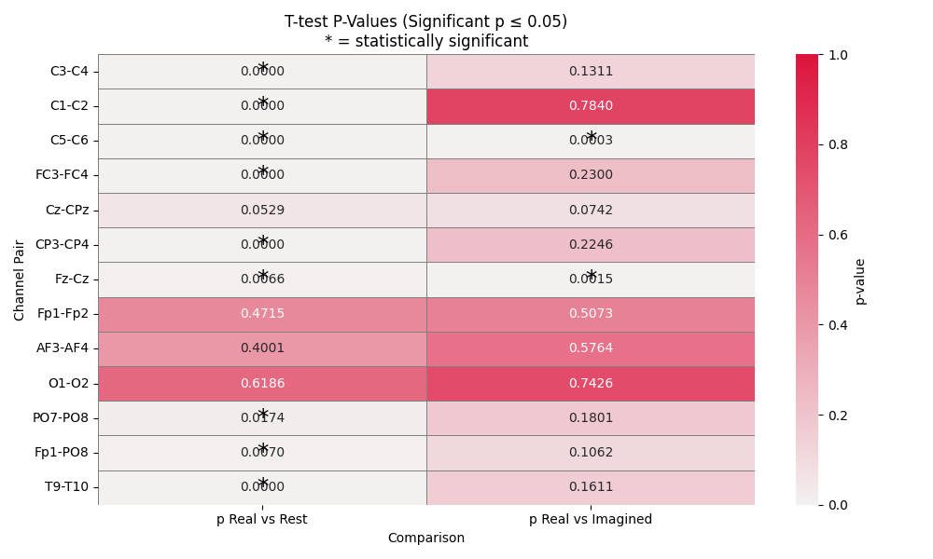
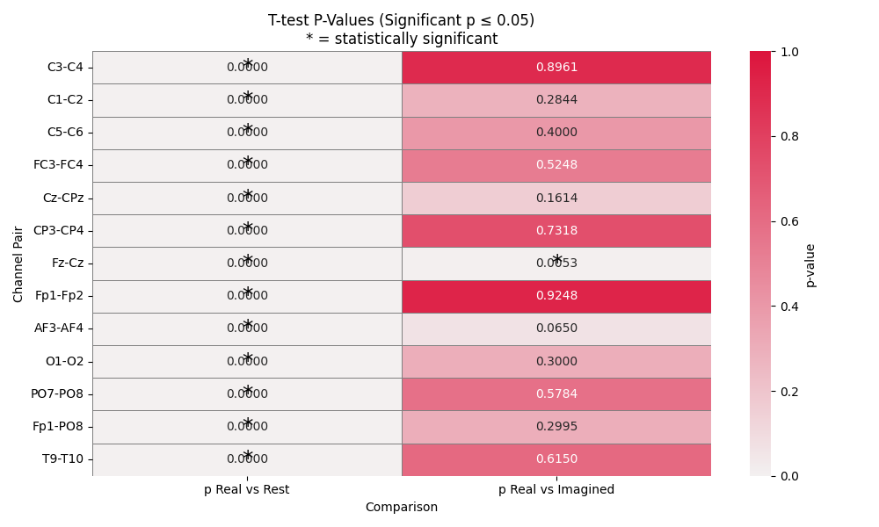
T-Test for PLV and iPLV
Notes:
T-Test Bonferroni Corrected (similar result for wPLI)

Slide 15
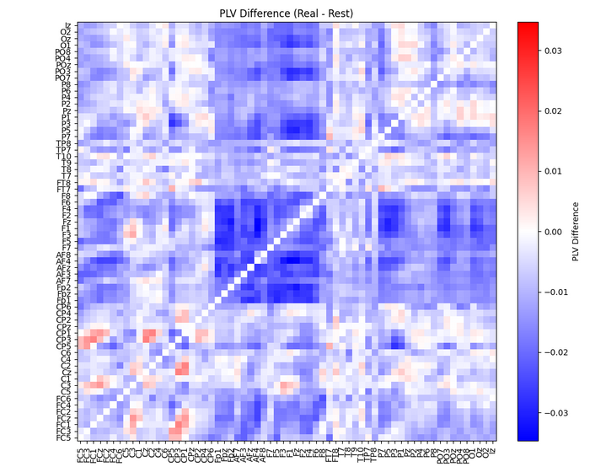
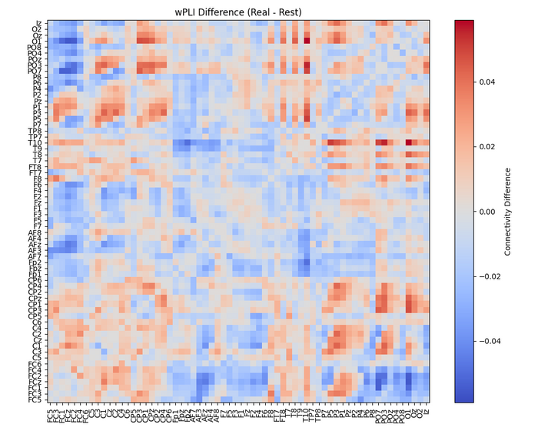
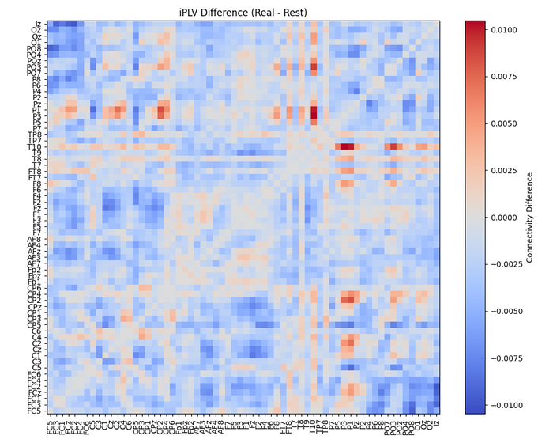
Matrix differences for Real vs Rest

Slide 16
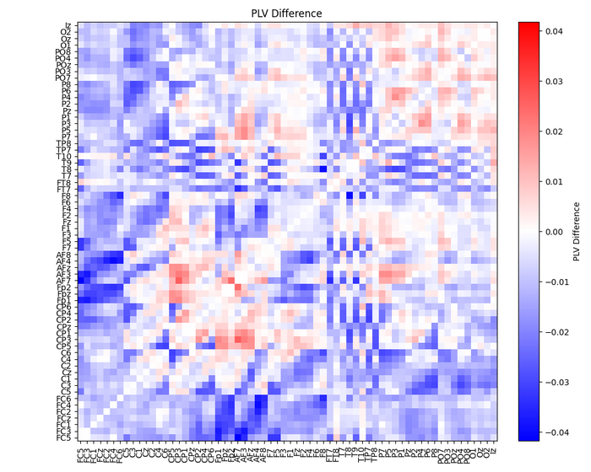
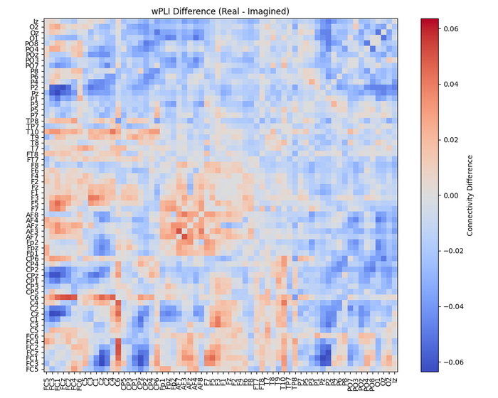
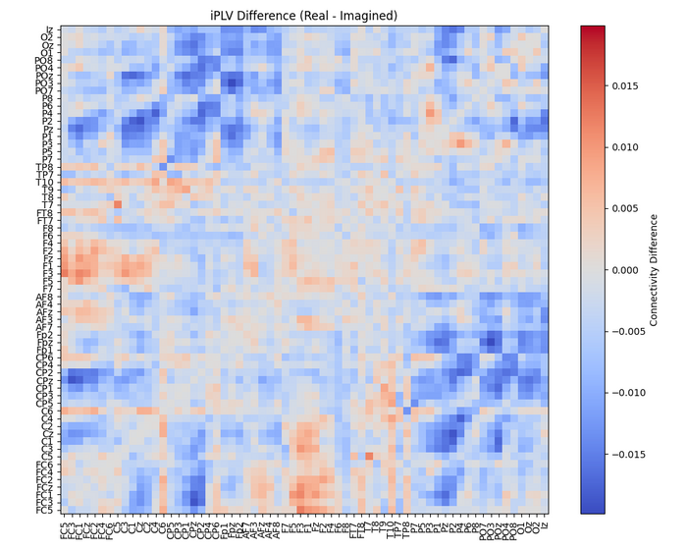
Matrix differences for Real vs Imagined

Slide 17
Classification

Slide 18
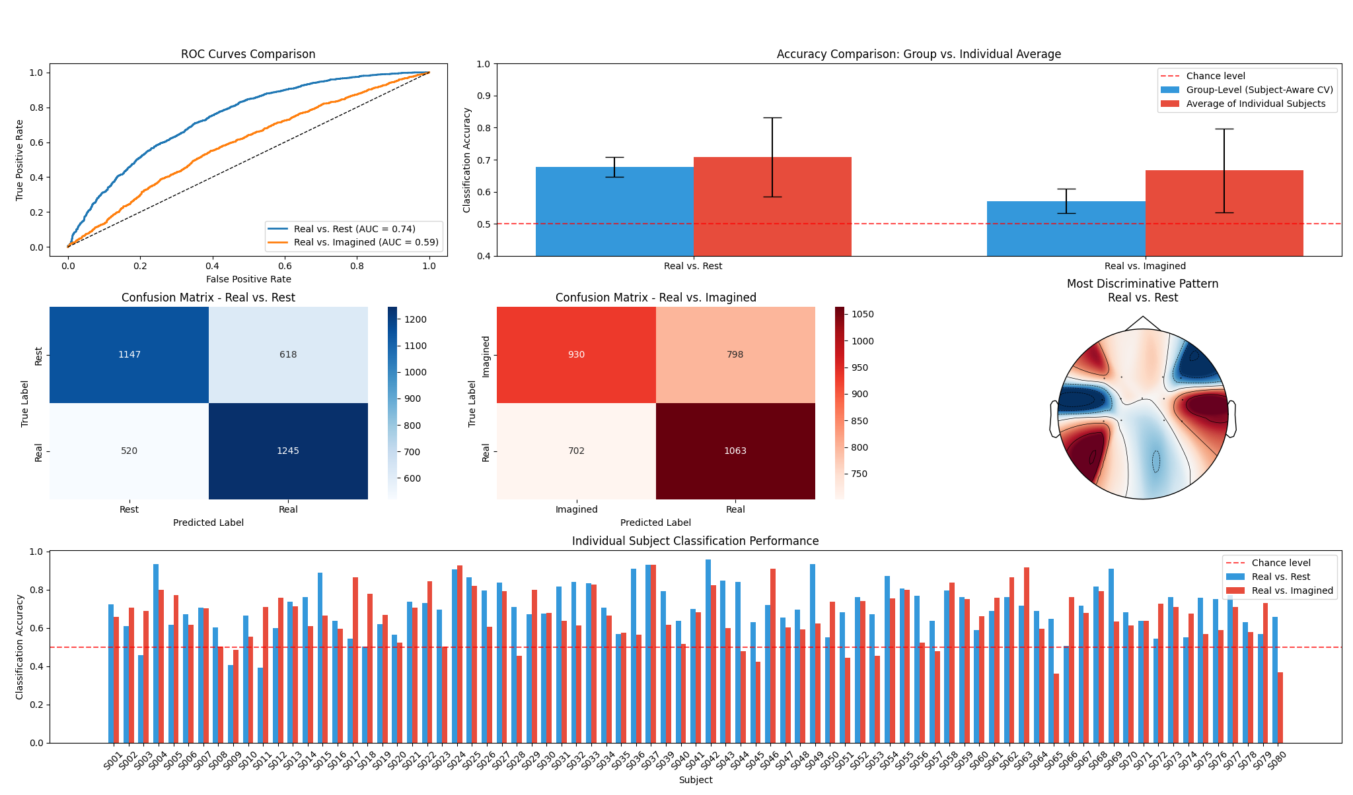

Slide 19
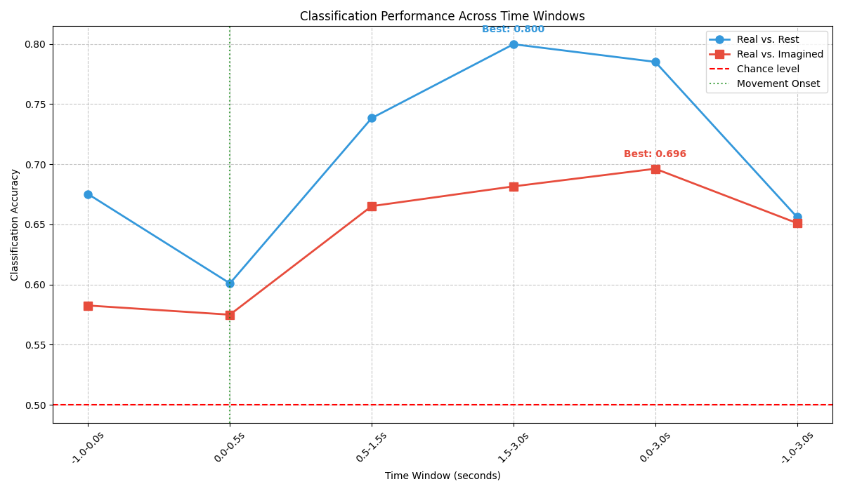

Slide 20
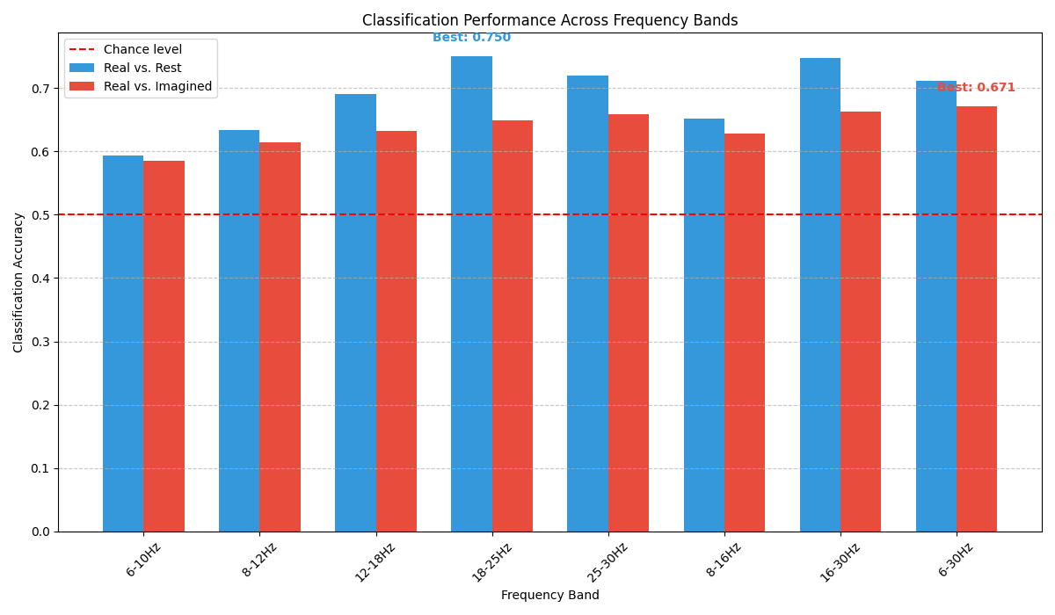

Slide 21
DFA Metric

Slide 22
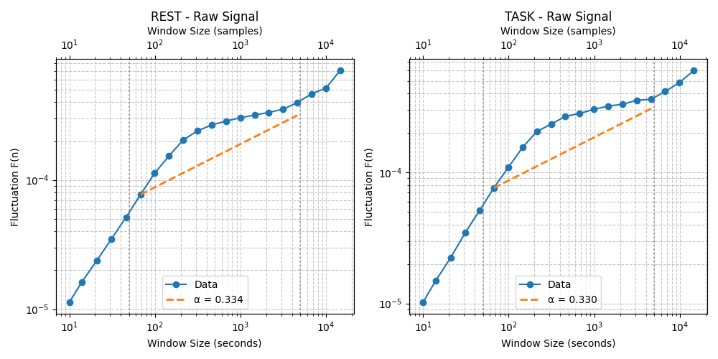
DFA Applied on Raw Signal

Slide 23
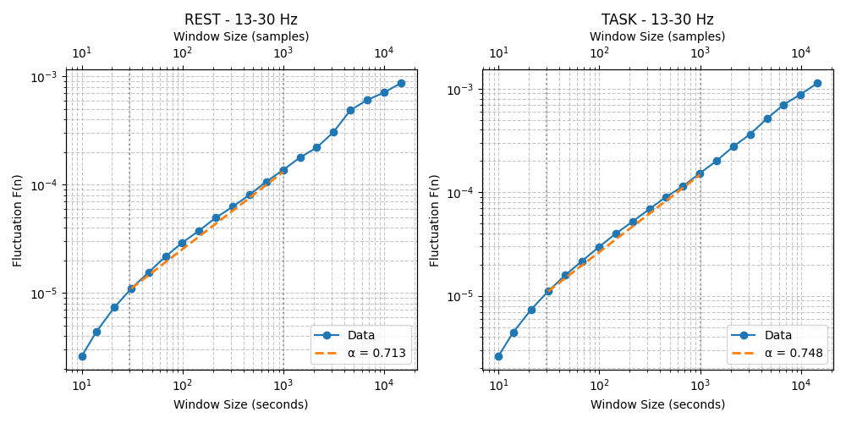
DFA Applied on β Band

Slide 24
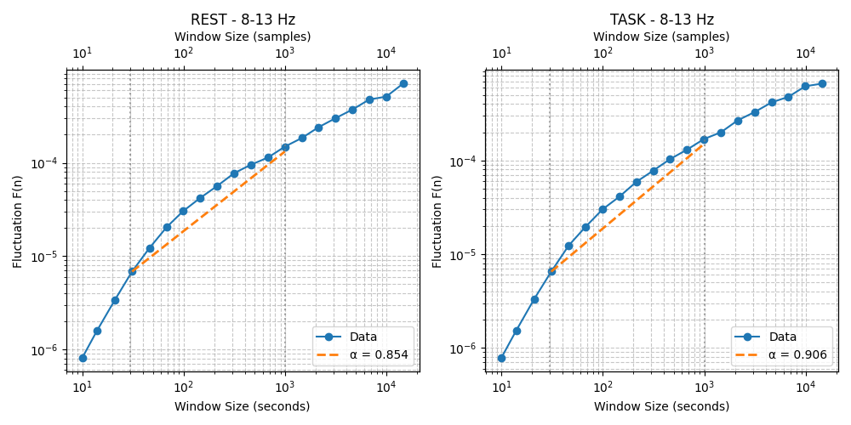
DFA Applied on α Band

Slide 25
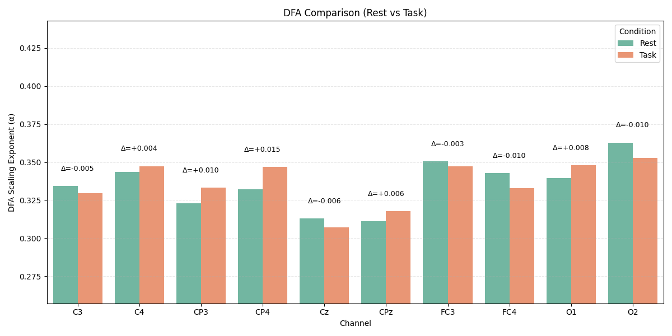

Slide 26
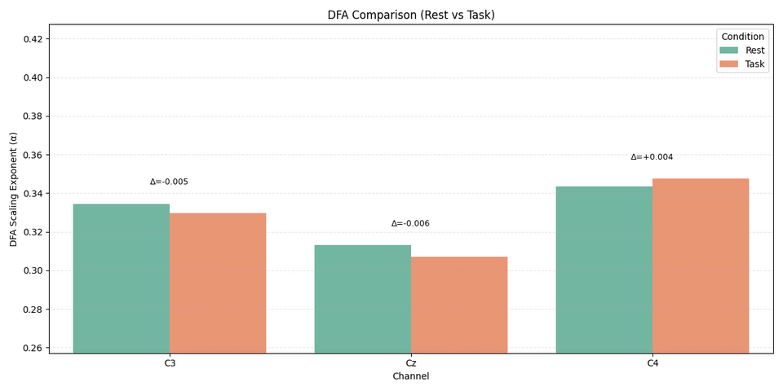
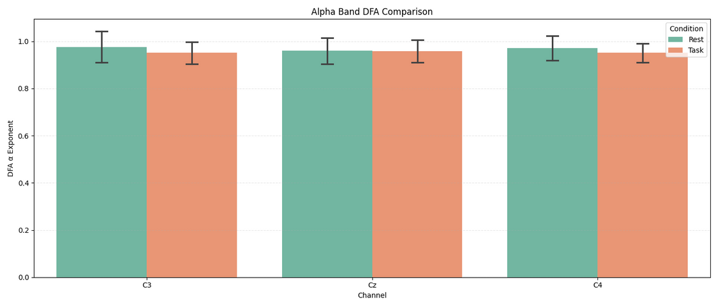
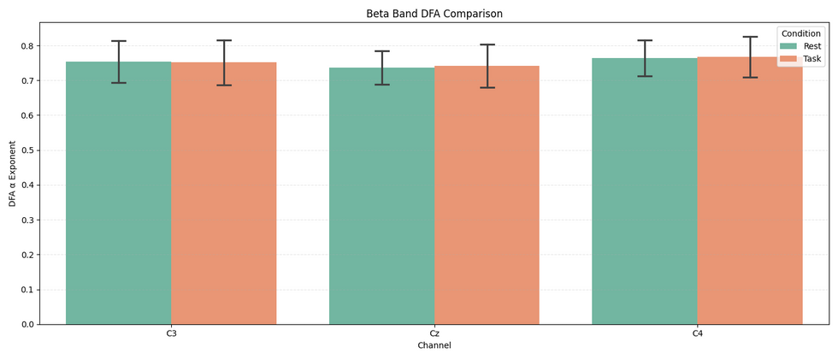
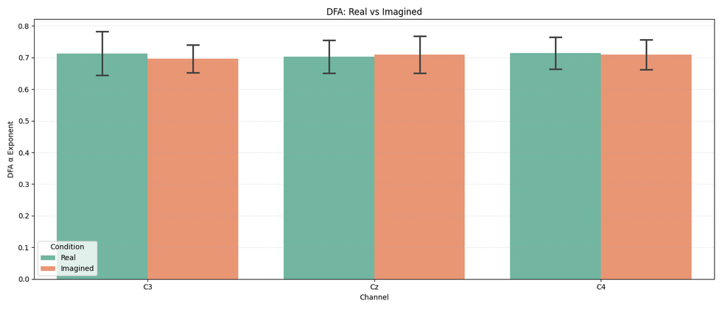

Slide 27
Conclusion (Real vs Imagined movement)
- They have similar activation
- They have similar activation patterns
- They have similar DFA values

Slide 28
“The latter outcome is not tragic, as failure is what scientists experience every day in the lab. Resilience to failure, humiliation, and rejection are the most important ingredients of a scientific career.”
- György Buzsáki, in The Brain from Inside Out

Slide 29
References
Sugata, Hisato, et al. "Common neural correlates of real and imagined movements contributing to the performance of brain–machine interfaces." Scientific reports 6.1 (2016): 24663.
Yuan, Han, Christopher Perdoni, and Bin He. "Relationship between speed and EEG activity during imagined and executed hand movements." Journal of neural engineering 7.2 (2010): 026001.
Galdo-Alvarez, Santiago, et al. "Functional equivalence of imagined vs. real performance of an inhibitory task: an EEG/ERP study." Frontiers in Human Neuroscience 10 (2016): 467.
Özmen, Nurhan Gürsel. "EEG analysis of real and imaginary arm movements by spectral coherence." Uludağ Üniversitesi Mühendislik Fakültesi Dergisi 26.1 (2021): 109-126.
Ferracuti, Francesco, et al. "Comparing between different sets of preprocessing, classifiers, and channels selection techniques to optimise motor imagery pattern classification system from EEG pattern recognition." Brain sciences 12.1 (2021): 57.
Alomari, Mohammad H., Aya Samaha, and Khaled AlKamha. "Automated classification of L/R hand movement EEG signals using advanced feature extraction and machine learning." arXiv preprint arXiv:1312.2877 (2013).

